Slide 1
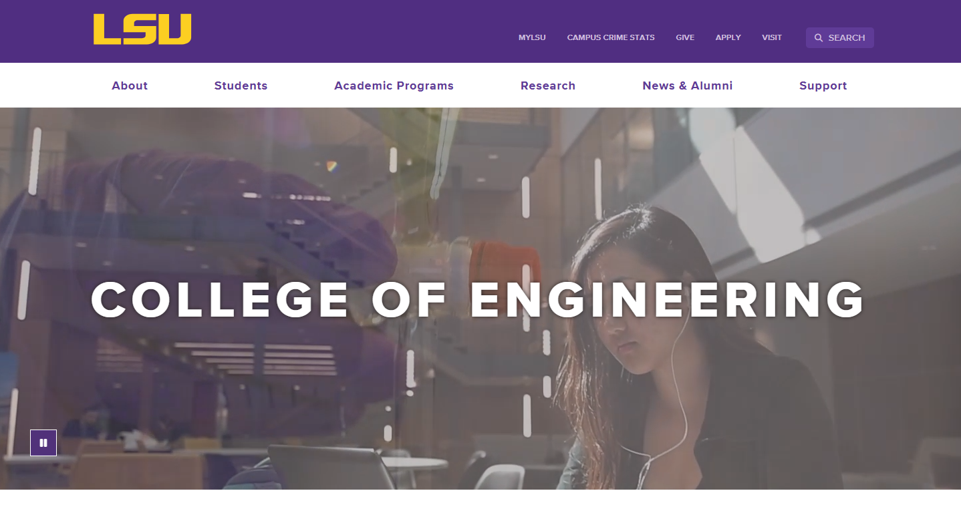
LSU COLLEGE OF ENGINEERING
Division Website
Focus Group – Staff/Parents
Eddie Manes
Digital Communications Manager
Casey Muller
Creative Strategist
Libby Haydel
Communications Manager

Slide 2
Evaluate Sites for
Usability
Functionality
Identify missing information

Slide 3
CMS Overview -
Modern Campus
Accessibility Compliance
Mobile-friendly
University brand consistency
Variety of user experience

Slide 4


Website Comparison
https://www.lsu.edu/_fierce-draft/eng/cse/index.php
https://www.ou.edu/coe/cs

Slide 5
Introduction to
College Site
-White Nav Bar
www.lsu.edu/eng

Slide 6
Introduction to
Division Site (NEW)
-Purple Nav Bar
-CSE wiki
https://www.lsu.edu/_fierce-draft/eng/cse/index.php

Slide 7
Introduction to
Legacy Sites (CURRENT)
-Purple Nav Bar
-older sites, still relevant
information
https://www.lsu.edu/eng/cse

Slide 8
Basic Tasks
Division Site
https://www.lsu.edu/_fierce-draft/eng/cse/index.php
https://www.ou.edu/coe/cs
Laptop (75%) vs. Mobile (25%)

Slide 9
CHOOSE FIVE, PERFORM ON BOTH SITES,
TAKE NOTES
Find the mission statement or an overview of the department.
Identify the contact information for the department office.
Locate the faculty directory and find a specific professor’s profile.
Search for recent department news or announcements.
Locate information on student advising services.
Search for student organizations affiliated with the department.
FEEL FREE TO ASK QUESTIONS AND SPEAK OUT OPINIONS FOR US TO TAKE NOTES ALSO.

Slide 10
Lunch and Discussion

Slide 11
Tailored Tasks
Division Site
https://www.ou.edu/coe/cs

Slide 12
TAILORED TASKS – Staff, Parents, Alumni
CHOOSE FIVE, PERFORM ON BOTH SITES, TAKE NOTES
Find an overview of the department’s academic programs (majors, minors, concentrations).
Locate admission requirements for undergraduate and graduate students.
Find out about application deadlines and where to apply.
Determine how to request a campus visit or virtual tour for a prospective student.
Look up scholarship opportunities and financial aid information for students.
Find tuition and fee estimates for in-state and out-of-state students.
Locate information about internship and co-op opportunities for students.
Read about career outcomes and salary expectations for graduates in this department.
Find information about student support services (advising, tutoring, mental health resources).
Determine how parents can receive print materials or brochures about the program.
Find a way to contact an academic advisor to ask about degree programs.
Look up housing options for students (on-campus and off-campus).
Find information about Baton Rouge’s cost of living, safety, and schools for families.
Locate information about alumni networking events and reunions.
Find a way for alumni to join the department’s mailing list.
Look up recent alumni success stories or testimonials.
Find out how alumni can donate or give back to the department.
Identify extracurricular and academic enrichment opportunities for students, including clubs, organizations, professional societies, and undergraduate research programs.
Locate a department faculty member working in an area of interest and find out how to contact them.
Forward information about the program requirements and application onto their children

Slide 13
Basic Task Creation
Division Site
5 minutes

Slide 14
Task Seeking
Division Site
10 minutes

Slide 15
Basic Task Creation
College Site
5 minutes

Slide 16
Task Seeking
College Site
10 minutes

Slide 17
Closing and
Next Steps

Slide 18
Thank you!

