Slide 1
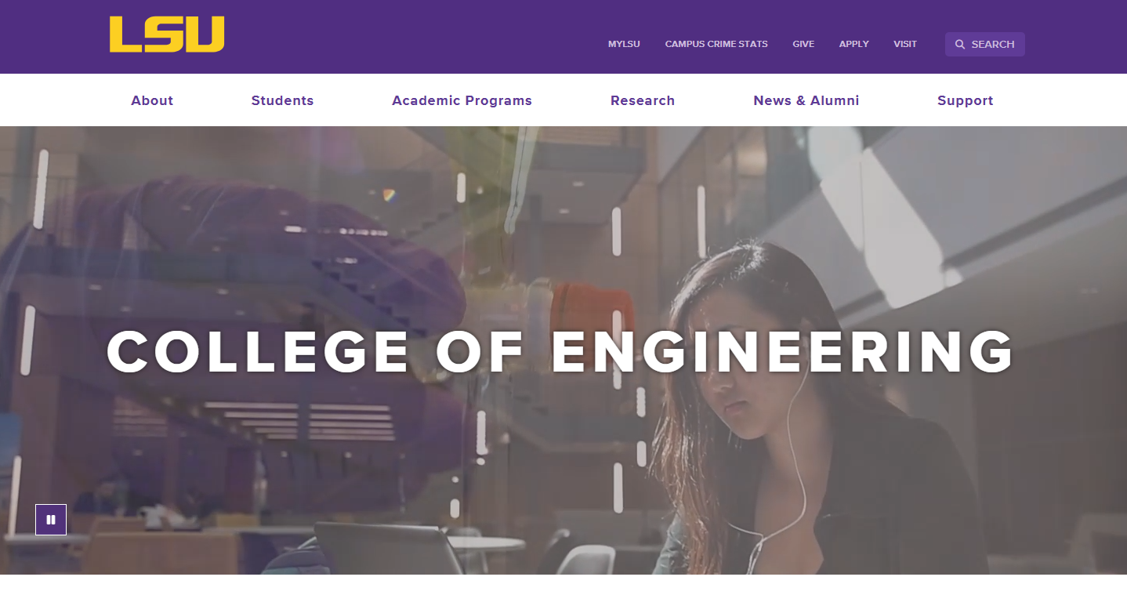
LSU COLLEGE OF ENGINEERING
Division Website
Focus Group – Graduate Students
Eddie Manes
Digital Communications Manager
Casey Muller
Creative Strategist
Libby Haydel
Communications Manager

Slide 2
Evaluate Sites for
Usability
Functionality
Identify missing information

Slide 3
CMS Overview -
Modern Campus
Accessibility Compliance
Mobile-friendly
University brand consistency
Variety of user experience

Slide 4


Website Comparison
https://www.lsu.edu/_fierce-draft/eng/cse/index.php
https://www.ou.edu/coe/cs

Slide 5
Introduction to
College Site
-White Nav Bar
www.lsu.edu/eng

Slide 6
Introduction to
Division Site (NEW)
-Purple Nav Bar
-CSE wiki
https://www.lsu.edu/_fierce-draft/eng/cse/index.php

Slide 7
Introduction to
Legacy Sites (CURRENT)
-Purple Nav Bar
-older sites, still relevant
information
https://www.lsu.edu/eng/cse

Slide 8
Basic Tasks
Division Site
https://www.lsu.edu/_fierce-draft/eng/cse/index.php
https://www.ou.edu/coe/cs
Laptop (75%) vs. Mobile (25%)

Slide 9
CHOOSE FIVE, PERFORM ON BOTH SITES,
TAKE NOTES
Find the mission statement or an overview of the department.
Identify the contact information for the department office.
Locate the faculty directory and find a specific professor’s profile.
Search for recent department news or announcements.
Locate information on student advising services.
Search for student organizations affiliated with the department.
FEEL FREE TO ASK QUESTIONS AND SPEAK OUT OPINIONS FOR US TO TAKE NOTES ALSO.

Slide 10
Lunch and Discussion

Slide 11
Tailored Tasks
Division Site
https://www.ou.edu/coe/cs

Slide 12
TAILORED TASKS
CHOOSE FIVE, PERFORM ON BOTH SITES, TAKE NOTES
Find the application requirements and deadlines for the graduate program.
Locate information about faculty research areas.
Identify available funding options, such as assistantships or scholarships.
Find the graduate student degree progress policies.
Check how to contact an advisor or program coordinator.
Find details about graduate student organizations or networking opportunities.
Locate the course catalog and check required courses for your program.
Search for lab or research facility access policies.
Identify internship or co-op opportunities for graduate students.
Check the process for registering for courses.
Locate information on thesis/dissertation submission guidelines.
Find department-specific job placement statistics.
Search for PhD-specific admission and program requirements.
Find out which faculty work in a specific area of interest and email them about a Zoom call/meeting.
Read about the success and outcomes for PhD graduates in this discipline. Understand the top three reasons that students choose to attend LSU or OU.
Find the key reasons or selling points that attract students to LSU or OU.
Find application instructions and fee waiver information for prospective students.

Slide 13
Basic Task Creation
Division Site
5 minutes

Slide 14
Task Seeking
Division Site
10 minutes

Slide 15
Basic Task Creation
College Site
5 minutes

Slide 16
Task Seeking
College Site
10 minutes

Slide 17
Closing and
Next Steps

Slide 18
Thank you!

